Slide 1
Blockcipher-Based Key Commitment for Nonce-Derived Schemes
Panos Kampanakis, Shai Halevi, Nevine Ebeid, and Matt Campagna
Sr. Applied Scientist
Amazon Web Services (AWS)

Slide 2
Outline
Nonce-Derived Schemes
Key Commitment
XAES-256-GCM with Key Commitment
FIPS Compliance
Data Limits
Security Analysis of the Key Commitment
Performance

Slide 3
Nonce-derived Key Schemes
Authenticated Encryption with Additional Data (AEAD) schemes have challenges:
Small number of messages per key in a cloud system
Vulnerable to attacks if IVs are mistakenly used
No key commitment
Nonce-derived key schemes address some of these issues without increasing the block size of the block cipher.

Slide 4
Why Nonce-Derived Schemes?
AES-GCM pain points:
IV is only 96 bits => exacerbates nonce-reuse problems loss of message authentication + leakage of plaintext pairs where re-use occurred
Random IVs => at most 2³² messages
Deterministic IVs => small fixed-length field & complexity
Notes:
1. managing the IV and making sure it does not repeat across distribute systems (cloud) is not straightforward). You do not need to write it as text, you can just say it.

Slide 5






Random IVs and the 2³² invocation limit
High-volume Transport Encryption for virtualized networks
High-volume AWS KMS Encryption
Distributed transport encryption can collectively encrypt ~2³² messages in 2 seconds.
Re-keying every 2 seconds is not practical.
AWS Key Management Service (AWS KMS) key sometimes can encrypt 2³² plaintexts / week.
Rekeying weekly and managing AWS keys for thousands of accounts annually adds overhead.
AWS KMS key
>>2³² / week (in some cases)
Encrypted Transport Traffic
AWS KMS
…
Fleet of HSMs
Fleet of devices
Notes:
These use-cases were shared in the NIST Block Cipher Modes Workshop 2023
managing the IV and making sure it does not repeat across distribute systems (cloud) is not straightforward
Transport Encryption
extremely short rotation periods impose operational risk, large number of encryption devices that share a single key
Cannot use then stateless random IV
KMS
where a customer managed key (CMK) is only accessible within a FIPS 140-2 Level 3 HSM
The CMK is used to both encrypt/decrypt small plaintext values and request encrypted data keys
a customer to exceed 2^32 calls under a CMK within a year
Q: What does the diagram say? What is AWS KMS key and its relation to the CMK?

Slide 6
Deterministic 96-bit IVs
Transport Encryption deterministic IV challenges
Transport Encryption FIPS challenges
IV
Identifier
Counter
…
…
Need >32 bits
Need ≥ 64 bits
Support for large # of identifiers limits the counter size which means less messages per key.
Unique identifiers in distributed systems add complexity.
We prefer random IVs.
Proving IV uniqueness is hard when there are many devices to manage.
Efficient counter management adds complexity.
We prefer random IVs.
Notes:
1. managing the IV and making sure it does not repeat across distribute systems (cloud) is not straightforward

Slide 7
Nonce-Derived Schemes
U = Nonce1
A
P
KDF
K_{U}
AES-GCM Encrypt
K
IV = Nonce2
C
T
A new key, K_{U}, is derived for each invocation on a new message.
Reduces (K_{U}, IV) collision probability.

Slide 8
XAES-256-GCM
Filippo Valsorda https://github.com/C2SP/C2SP/blob/main/XAES-256-GCM.md
K
U=N[:12] IV=N[12:]
24-byte
nonce N
Init: K1 := $X ×$ AES256_{K}(0) // multiplication by $X$ in $\text{GF}(2^{n})$
NIST SP800-108 KDF-CTR with CMAC
K₁
K₁
0x0001 || “X” || 0x00 || N[:12]
0x0002 || “X” || 0x00 || N[:12]
AES256_{K}
AES256_{K}
A, P
K_{U}
K_{U}[0:16]
K_{U} [16:32]
AES-GCM
IV= N[12:]
C
T
CMAC_AES256_{K}(0x0001 || “X” || 0x00 || N[:12])
|| CMAC_AES256_{K}(0x0002 || “X” || 0x00 || N[:12])
Notes:
Adds 3 AES calls compared to other key derivation schemes that can use HMAC or HKDF.

Slide 9


Why Key Commitment?
C T
K₁
AES-GCM Decrypt
K₂
AES-GCM Decrypt
Nonce
Nonce
P₁
Sell 1000 shares
Buy 1000 shares
P₂
AES-GCM has no protection against a ciphertext decrypting to two valid plaintexts under two different keys.
Solution: Bind the Key to inputs such as the Nonce and put a “stamp” on it.
Notes:
Q: Is it ok that I put the same Nonce as input to both?
When choosing the keys is under the control of the attacker
E.g. in storage systems: attacker encrypts with one key, rotates it and makes the system decrypt with another key, fooling the reader

Slide 10
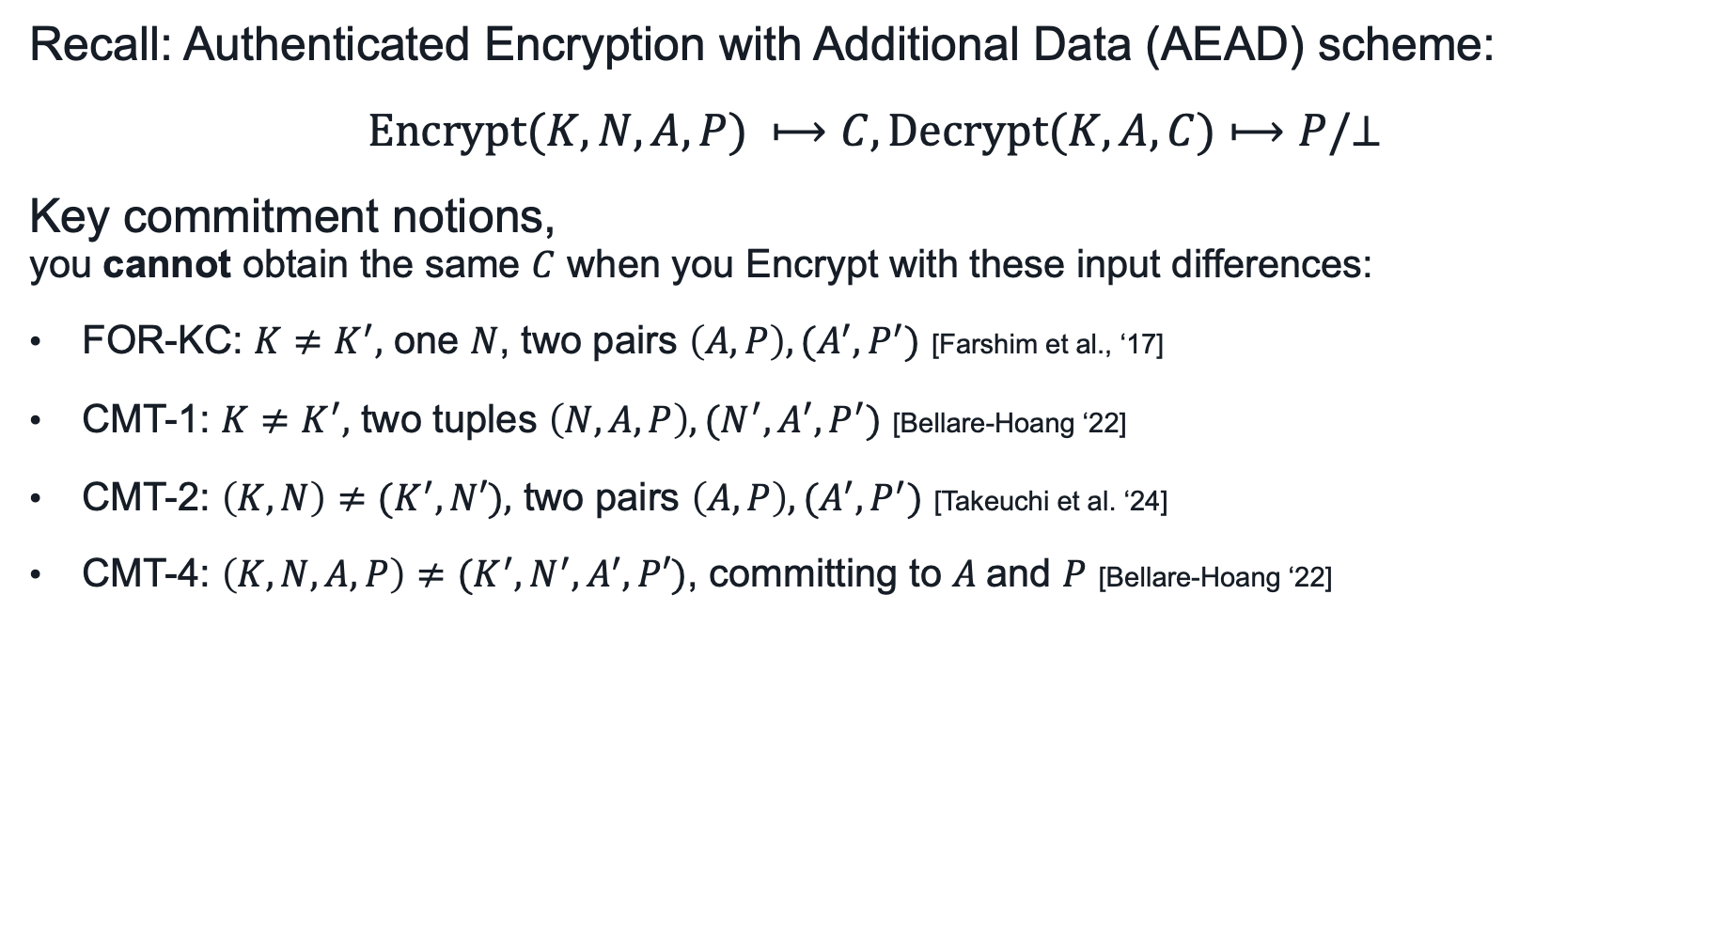

Key Commitment
Recall: Authenticated Encryption with Additional Data (AEAD) scheme:
$$Encrypt(K,N,A,P) ⟼C, Decrypt(K,A,C)⟼P/⊥$$
Key commitment notions, you cannot obtain the same $C$ when you Encrypt with these input differences:
FOR-KC: $K≠K^{′},$ one $N$, two pairs $\left(A,P\right),(A^{′},P^{′})$ [Farshim et al., ‘17]
CMT-1: $K≠K^{′},$ two tuples $\left(N,A,P\right),(N^{′},A^{′},P^{′})$ [Bellare-Hoang ‘22]
CMT-2: $\left(K, N\right)≠{(K}^{′},N′),$ two pairs $\left(A,P\right),(A^{′},P^{′})$ [Takeuchi et al. ‘24]
CMT-4: $\left(K, N, A, P\right)≠{(K}^{′},N^{′}, A^{′},P′)$, committing to $A$and $P$ [Bellare-Hoang ‘22]
Not distinct in typical AEAD when $N$ is stored with $C$
Notes:
FOR-KC, CMT-1 and CMT-2 are the same if the nonce is part of the cipher-text, which is usually the case in AEAD
Q: difference in notation: $\left(K, N\right)≠{(K}^{′},N′),$ means $K≠K^{′}$ and $N≠N^{′}$ ? No, it means that together, they’re different. (A,P), (A’,P’) can be different or not.

Slide 11
K
U=N[:12] IV=N[12:]
24-byte
nonce N
Init: K1 := $X ×$ AES256_{K}(0) // multiplication by $X$ in $\text{GF}(2^{n})$
A, P
K_{U}
AES-GCM
IV= N[12:]
NIST SP800-108 KDF-CTR with CMAC
“XCMT” || N[:12]
C
T
KC
AES256_{K}
K₁
K₁
N[12:] || 0x00010001
N[12:] || 0x00010002
AES256_{K}
AES256_{K}
KC[0:16]
KC [16:32]
CMAC_AES256_{K}(“XCMT”∥ U ∥ IV ∥ 0x00010001)
|| CMAC_AES256_{K}(“XCMT”∥ U ∥ IV ∥ 0x00010002)

Slide 12

K
U=N[:12] IV=N[12:]
24-byte
nonce N
Init: K1 := $X ×$ AES256_{K}(0) // multiplication by $X$ in $\text{GF}(2^{n})$
NIST SP800-108 KDF-CTR with CMAC
K₁
K₁
FIPS
0x0001 || “X” || 0x00 || N[:12]
0x0002 || “X” || 0x00 || N[:12]
AES256_{K}
AES256_{K}
A, P
FIPS
K_{U}
AES-GCM
IV= N[12:]
K_{U}[0:16]
K_{U} [16:32]
NIST SP800-108 KDF-CTR with CMAC
“XCMT” || N[:12]
C
T
KC
AES256_{K}
K₁
K₁
N[12:] || 0x00010001
N[12:] || 0x00010002
AES256_{K}
AES256_{K}
KC[0:16]
KC [16:32]
Notes:
FIPS is Federal Information Processing Standards, a US/Canada program that tests and validates cryptographic modules and grants certificates to those that pass, which then can be used to process government data. Performance is important.

Slide 13
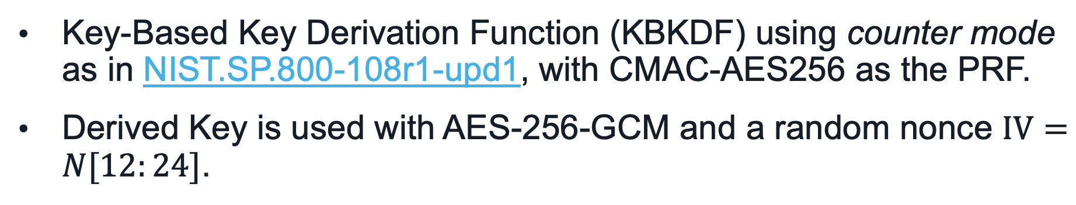
FIPS Compliance
Key-Based Key Derivation Function (KBKDF) using counter mode as in NIST.SP.800-108r1-upd1, with CMAC-AES256 as the PRF.
Derived Key is used with AES-256-GCM and a random nonce $IV=N[12:24]$.

Slide 14
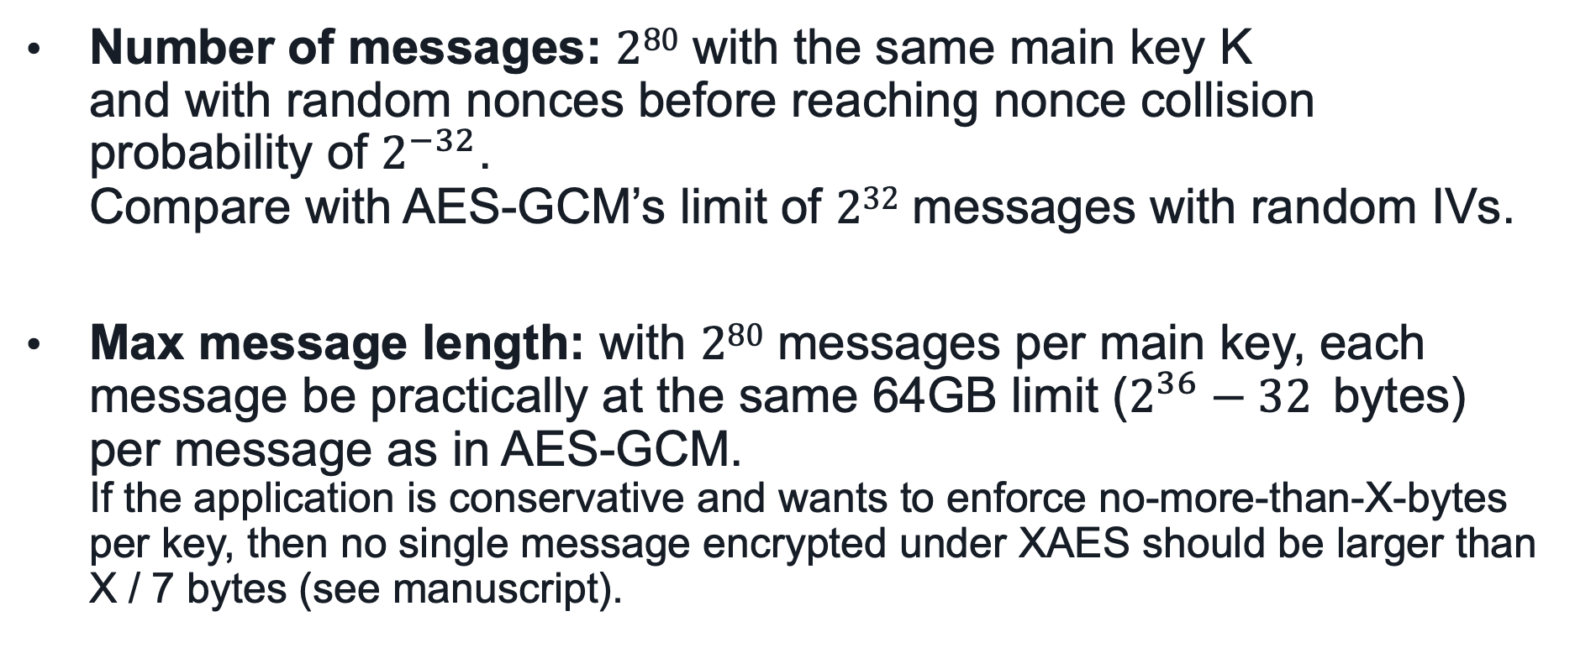
Data Limits
Number of messages: $280$ with the same main key K and with random nonces before reaching nonce collision probability of $2^{−32}$. Compare with AES-GCM’s limit of $232$ messages with random IVs.
Max message length: with $280$ messages per main key, each message be practically at the same 64GB limit ($2^{36}−32$ bytes) per message as in AES-GCM. If the application is conservative and wants to enforce no-more-than-X-bytes per key, then no single message encrypted under XAES should be larger than X / 7 bytes (see manuscript).

Slide 15
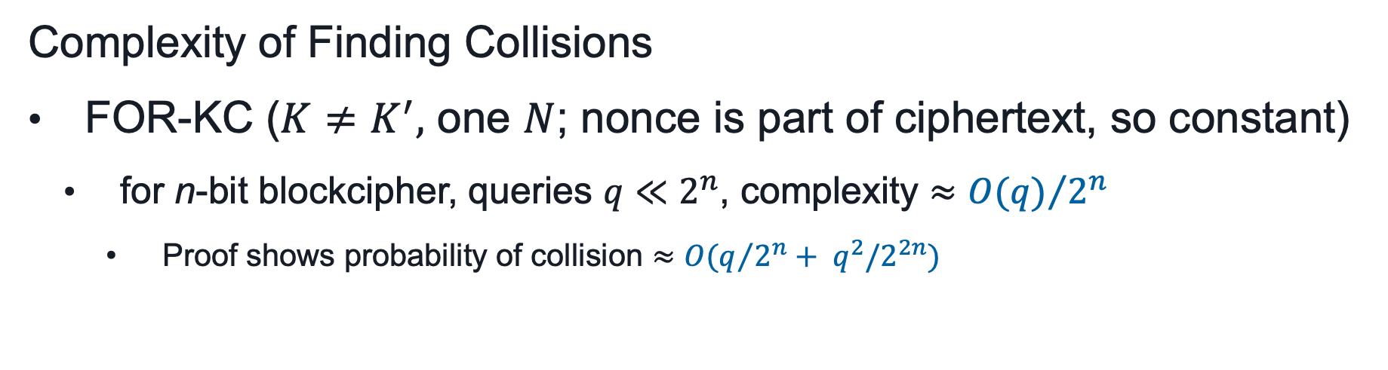
Security Analysis of the Key Commitment
Complexity of Finding Collisions
FOR-KC ($K≠K^{′},$ one $N$; nonce is part of ciphertext, so constant)
for n-bit blockcipher, queries $q≪2^{n}$, complexity $≈{O(q)}/{2^{n}}$
Proof shows probability of collision $≈{O(q}/{2^{n}}+ q^{2}/2^{2n})$
Notes:
CMT-2 commitment scheme ($\left(K, N\right)≠{(K}^{′},N′)$; nonce is not constant, implied, not part of ciphertext)
for n-bit blockcipher, complexity $≈2^{n/2}$; for AES-based construction, complexity $≈2^{64}$

Slide 16
K
N[:12] N[12:]
24-byte
nonce N
Init: K1 := $X ×$ AES256_{K}(0) // multiplication by $X$ in $\text{GF}(2^{n})$
NIST SP800-108 KDF-CTR with CMAC
K₁
K₁
0x0001 || “X” || 0x00 || N[:12]
0x0002 || “X” || 0x00 || N[:12]
AES256_{K}
AES256_{K}
A, P
K_{U}
AES-GCM
IV= N[12:]
K_{U}[0:16]
K_{U} [16:32]
NIST SP800-108 KDF-CTR with CMAC
“XCMT” || N[:12]
C
T
KC
AES256_{K}
Init of AES-GCM: a) a key scheduling
b) an encryption of an all-zeroes input
c) A precomputation of the GHASH constants
K₁
K₁
N[12:] || 0x00010001
N[12:] || 0x00010002
AES256_{K}
AES256_{K}
KC[0:16]
KC [16:32]
Notes:
Overhead is the same, AES-GCM processing time doesn’t double with doubling the plaintext size.

Slide 17
Performance
Intel® Xeon® Platinum 8375C
(x86-64 processor)
Init of HMAC-AES: 2 SHA-256 calculations
Notes:
HMAC as PRF has been used in AWS KMS since 2014.

Slide 18
Performance
AWS Graviton4 - Neoverse V2, (AArch64 processor)

Slide 19

Deterministic 96-bit IVs
Transport Encryption deterministic IV challenges
Transport Encryption FIPS challenges
Fabric Encryption performance challenges
IV
Identifier
Counter
…
…
Need >32 bits
Need ≥ 64 bits
Support for large # of identifiers limits the counter size which means less messages per key.
Unique identifiers in distributed systems add complexity.
We prefer random IVs.
OTN / FlexO
~80KB frames = 5,000 AES blocks.
100x Gbps speeds
AES-GCM can be slow for 5,000 AES blocks at 400Gbps speeds.
IV uniqueness proof, reuse checks, zeroization in distributed, zero-downtime systems has challenges.
Efficient counter management adds complexity.
We prefer random IVs.
Notes:
1. managing the IV and making sure it does not repeat across distribute systems (cloud) is not straightforward

Slide 20
K
N[:12] N[12:]
24-byte
nonce N
XAES-256-GCM
Filippo Valsorda https://github.com/C2SP/C2SP/blob/main/XAES-256-GCM.md
Init: K1 := $X ×$ AES256_{K}(0) // multiplication by $X$ in $\text{GF}(2^{n})$
NIST SP800-108 KDF-CTR with CMAC
K₁
K₁
0x0001 || “X” || 0x00 || N[:12]
0x0002 || “X” || 0x00 || N[:12]
AES256_{K}
AES256_{K}
A, P
K_{U}[0:15]
K_{U} [16:31]
AES-GCM
IV= N[12:]
C
T

Slide 21
256-bit AES-GCM Key K
N[:12] N[12:]
24-byte
nonce N
CMAC-AES256 subkey K1
XAES-256-GCM
0x0001 || “X” || 0x00 || N[:12]
128 bits
Filippo Valsorda https://github.com/C2SP/C2SP/blob/main/XAES-256-GCM.md
Init:
K1 := X x AES256_{K}(0) // multiplication by X in GF(2n)
K
CMAC-AES256
AES256_{K}
CMAC-AES256 subkey K1
0x0002 || “X” || 0x00 || N[:12]
128 bits
K
AES256_{K}
CMAC-AES256
256-bit key K_{U}
Plaintext
128 bits
128 bits
K_{U}
AES-GCM
IV= N[12:]
AAD
C T

Slide 22
256-bit AES-GCM Key K
U[:12]
V[:12]
24-byte
nonce N
CMAC-AES256 subkey K1
“XCMT” || N[:12]
K
AES256_{K}
0x0001 || “X” || 0x00 || N[:12]
CMAC-AES256 subkey K1
C1[:16]
128 bits
K
N[12:] || 0x01000003
AES256_{K}
128 bits
CMAC-AES256(0x0001||“X”||0x00||N[:12])
K
CMAC-AES256(“XCMT”||N||0x0100(00)^{25-b}03)
AES256_{K}
CMAC-AES256 subkey K1
CMAC-AES256 subkey K1
0x0002 || “X” || 0x00 || N[:12]
N[12:] || 0x01000004
128 bits
128 bits
K
K
AES256_{K}
AES256_{K}
CMAC-AES256(“XCMT”||N||0x0100(00)^{25-b}04)
CMAC-AES256(0x0002||“X”||0x00||N[:12])
256-bit key K_{U}
256-bit commitment Kc
128 bits
128 bits
Plaintext
128 bits
128 bits
K_{U}
AES-GCM
IV= N[12:]
AAD
C T
Kc
Notes:
CMAC-based construction of key commitment to reuse components. (TODO: read paper section of motivation)

Slide 23
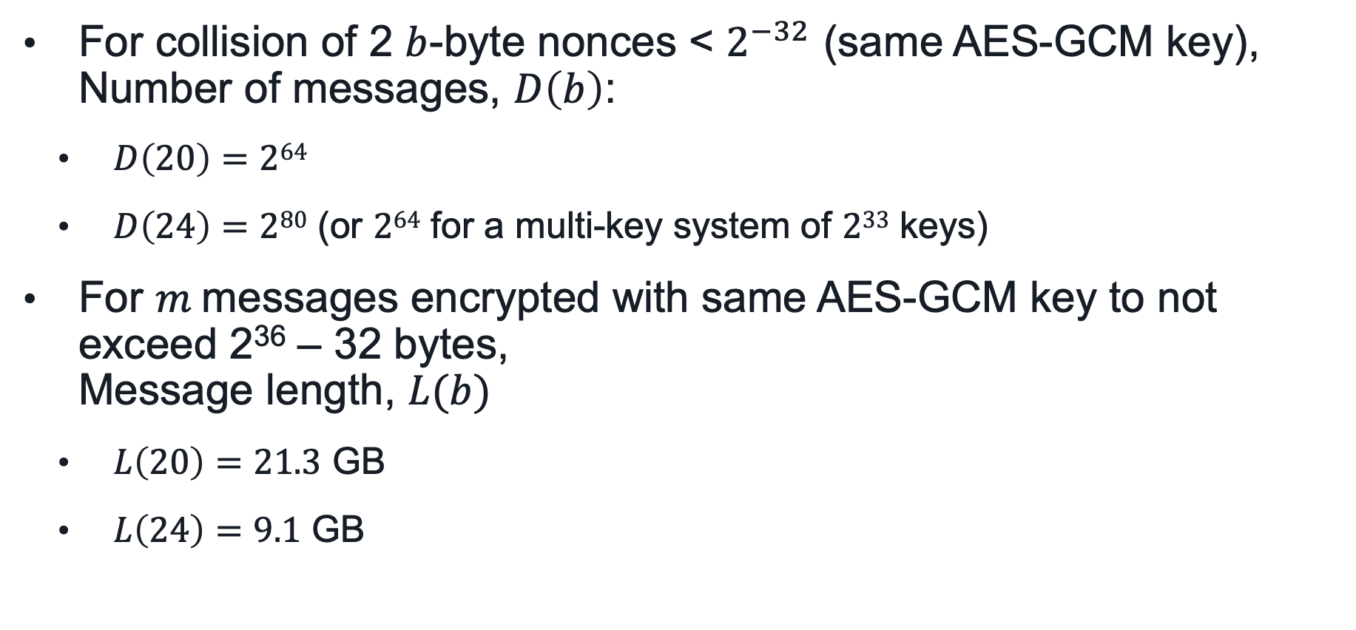
Data Limits
For collision of 2 $b$-byte nonces < $2^{−32}$ (same AES-GCM key), Number of messages, $D\left(b\right)$:
$D\left(20\right)=264$
$D\left(24\right)=280$ (or $264$ for a multi-key system of $233$ keys)
For $m$messages encrypted with same AES-GCM key to not exceed 2³⁶ – 32 bytes, Message length, $L(b)$
$L\left(20\right)=21.3$ GB
$L\left(24\right)=9.1$ GB

