Slide 1

Picking up the Fallen Mask:
Breaking and Fixing the RS-Mask Countermeasure
Dilara Toprakhisar, Svetla Nikova, Ventzislav Nikov
13/08/2025 SAC’25
Notes:
References add for CMS and all, say sth about uniformity in the beginning,
Explain the canright inversion

Slide 2
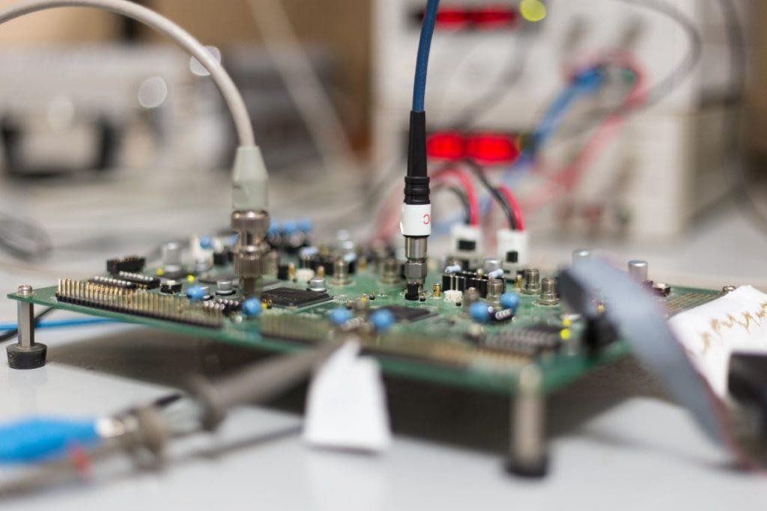
Physical Attacks
1- Passive Attacks
Side-Channel Analysis (SCA)
  Observable leakage
    e.g., Power consumption
  Countermeasures
    Masking
  Practical evaluation
    TVLA

Slide 3
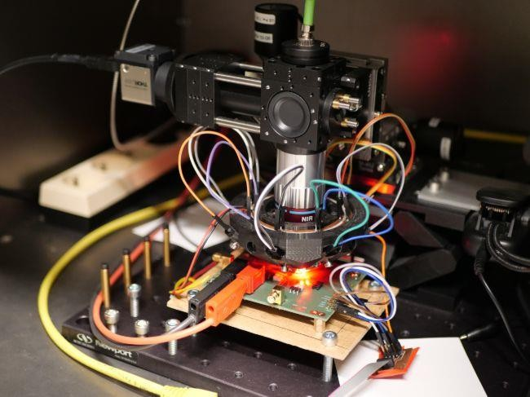
Physical Attacks
2- Active Attacks
Fault Attacks (FA)
  Intentional disturbance of computations
    e.g., Clock/voltage glitches
  Countermeasures
    Redundancy + masking
    Random space masking (RS-Mask¹)
1- K. Ramezanpour, P. Ampadu, W. Diehl: RS-Mask: Random Space Masking as an Integrated Countermeasure against Power and Fault Analysis

Slide 4
Physical Attacks
2- Active Attacks
Fault Attacks (FA)
  Practical evaluation
    Tool based (mostly smaller gadgets)
    Overlooked vulnerabilities
      CAPA²
      CINI-MINIS gadgets³
      RS-Mask
2- O. Reparaz, L. De Meyer, B. Bilgin, V. Arribas, S. Nikova, V. Nikov, N. P. Smart: CAPA: The Spirit of Beaver Against Physical Attacks
3- J. Feldtkeller, J. Richter-Brockmann, P. Sasdrich, T. Guneysu: CINI MINIS: Domain Isolation for Fault and Combined Security

Slide 5





RS-Mask
Goal: Maintain uniformity under fault injection
Core idea:
Protected AES
  First-order SCA
  First-order fault security
$$x$$
$$ℰ_{1}$$
$$g(⋅)$$
$$ℰ_{2}$$
$$z=g(x)$$
Notes:
Say here what the uniformity is

Slide 6
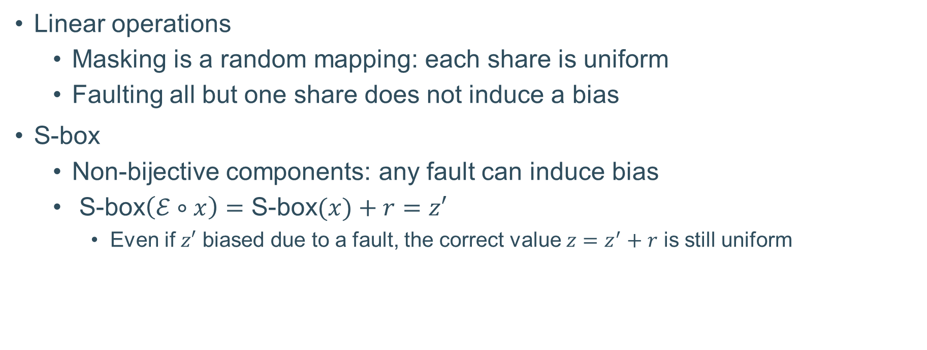
RS-Mask
Linear operations
  Masking is a random mapping: each share is uniform
  Faulting all but one share does not induce a bias
S-box
  Non-bijective components: any fault can induce bias
  S-box$\left(ℰ∘x\right)=$ S-box$(x)+r=z′$
    Even if $z′$ biased due to a fault, the correct value $z=z^{′}+r$ is still uniform

Slide 7
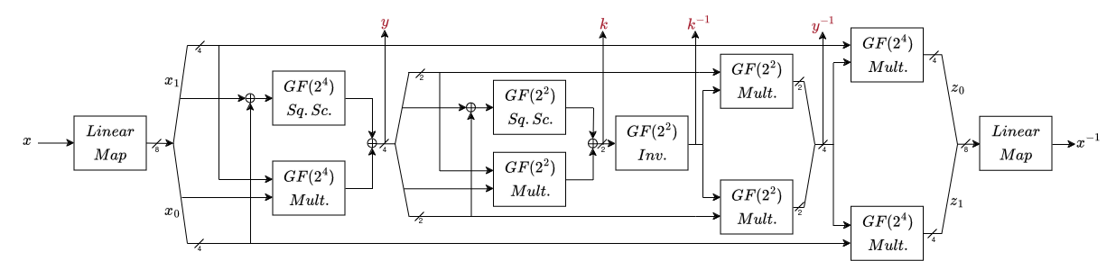
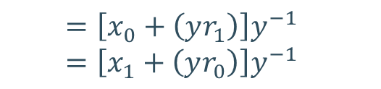
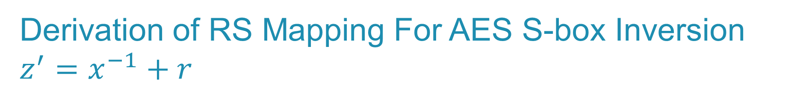
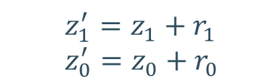



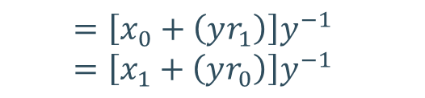

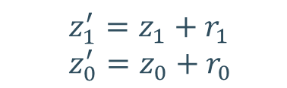
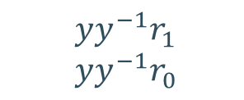
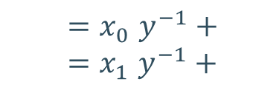

Derivation of RS Mapping For AES S-box Inversion $z^{′}=x^{−1}+r$
$$x≠0$$
$$y≠0, y^{−1}≠0, yy^{−1}=1$$
$$x=0$$
$$y=0, y^{−1}=0$$
  $$=\left[x_{0}+\left(yr_{1}\right)\right]y^{−1}$$
  $$=\left[x_{1}+\left(yr_{0}\right)\right]y^{−1}$$
  $$z_{1}^{′}=z_{1}+r_{1}$$
  $$z_{0}^{′}=z_{0}+r_{0}$$
  $$yy^{−1}r_{1}$$
  $$yy^{−1}r_{0}$$
  $${=x}_{0}y^{−1}+$$
  $${=x}_{1}y^{−1}+$$
  $$=\left[x_{0}+\left(yr_{1}\right)\right]y^{−1}$$
  $$=\left[x_{1}+\left(yr_{0}\right)\right]y^{−1}$$
    $$yy^{−1}r≠r$$
  $$z_{1}^{′}=z_{1}+r_{1}$$
  $$z_{0}^{′}=z_{0}+r_{0}$$
  $$z^{′}=0+r$$
  $$z^{′}={\left(r^{−1}\right)}^{−1}$$
Notes:
Canright construction breaks the inversion into smaller subfield operations

Slide 8
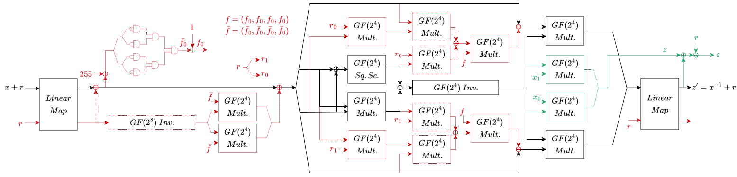

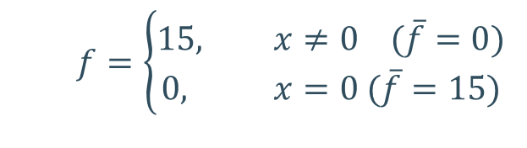
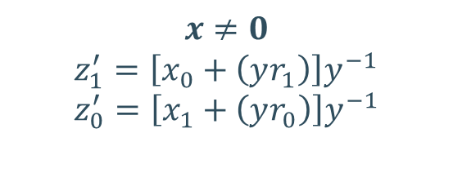


Derivation of RS Mapping for all $x$
$$x=0$$
$$z^{′}={\left(r^{−1}\right)}^{−1}$$
  $$x=x+r^{−1}\overline{f}$$
  $$z_{1}^{′}=\left[x_{0}+\left(yr_{1}\right)f\right]y^{−1}$$
  $$z_{0}^{′}=\left[x_{1}+\left(yr_{0}\right)f\right]y^{−1}$$
  $$f=\left\{\begin{aligned}15, x≠0 (\overline{f}=0) \\ &0, x=0 (\overline{f}=15)\end{aligned}\right.$$
$$x≠0$$
  $$z_{1}^{′}=\left[x_{0}+\left(yr_{1}\right)\right]y^{−1}$$
  $$z_{0}^{′}=\left[x_{1}+\left(yr_{0}\right)\right]y^{−1}$$

Slide 9
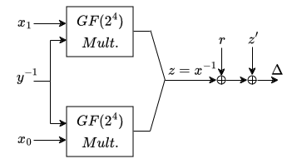


Security of RS-Mask
Statistical fault attacks
  The mutual information between $Z=X+R$ and $X$ is zero $↔$ $R$ is uniform
Differential fault attacks
  Infective RS-Mask
$=0$ if there is no fault

Slide 10


Security of RS-Mask
TVLA for SCA
Distribution analysis of faulty and correct S-box outputs
SIFA simulation
  Both using a single fault location

Slide 11
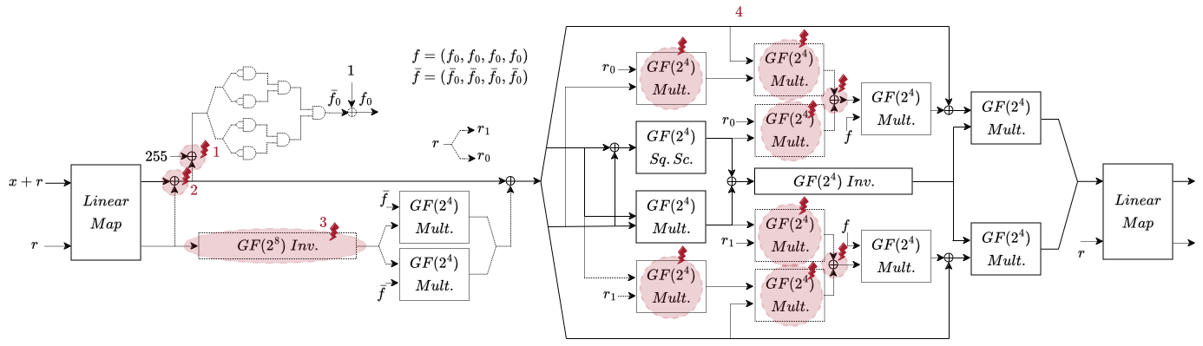
Security Analysis of RS-Mask
SIFA/DFA on four fault locations

Slide 12
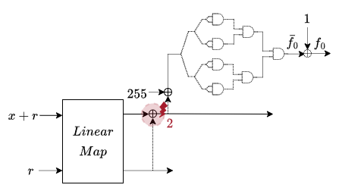



Fault Location 2 – S-box Input: $\left(x+r\right)+r$
$z^{′}={\left(x+Δ\right)}^{−1}+r$
Infection mechanism is using the same S-box input
  The fault cannot be detected
$$x=x+Δ$$

Slide 13
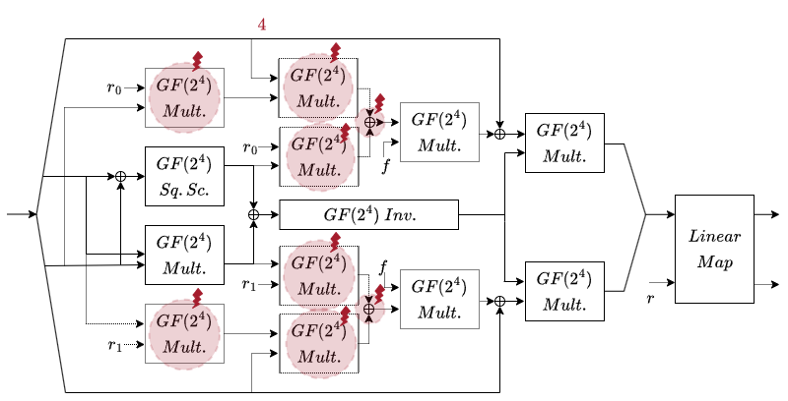
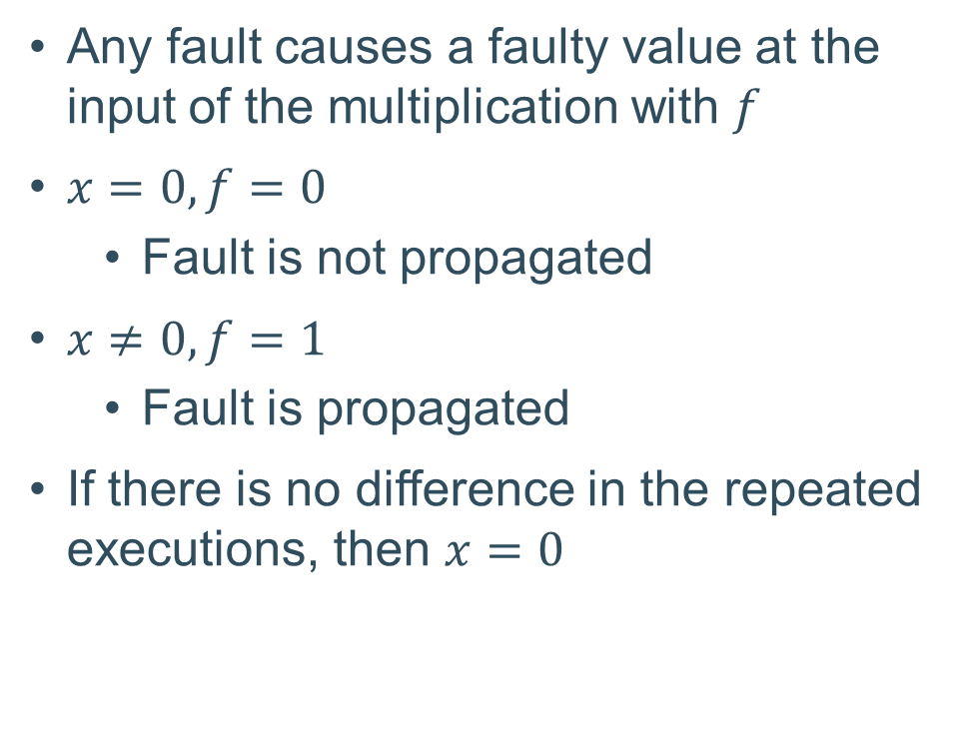


Fault Location 4 – Additional RS-Mask Circuit in Inversion
Any fault causes a faulty value at the input of the multiplication with $f$
$x=0, f=0$
  Fault is not propagated
$x≠0, f=1$
  Fault is propagated
If there is no difference in the repeated executions, then $x=0$
$$+Δ$$
$$+Δ$$

Slide 14

An AES-specific Countermeasure
Glitch extended robust $d$-probing model⁴
Gate/register-faulting model⁵
  Correctness: the adversary may receive an incorrect output, but it remains unexploitable
  Privacy: the probability of the abort signal is independent of the secrets
4- S. Faust, V. Grosso, S. M. D. Pozo, C. Paglialonga, F. Standaert: Composable Masking Schemes in the Presence of Physical Defaults & the Robust Probing Model
5- S. Dhooghe, A. Ovchinnikov, D. Toprakhisar: StaTI: Protecting against Fault Attacks Using Stable Threshold Implementations

Slide 15
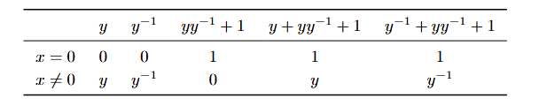

An AES-specific Countermeasure
  Goal: uniform mapping for all inputs
  $$→\left(y+yy^{−1}+1\right)\left(y^{−1}+yy^{−1}+1\right)=1$$
  $$→x_{0}\left(yy^{−1}+1\right)=0$$
  $$→x_{1}\left(yy^{−1}+1\right)=0$$

Slide 16



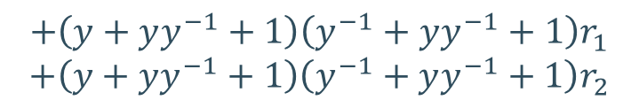
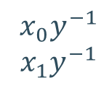
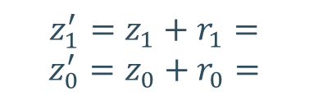
An AES-specific Countermeasure
  $$\left(y+yy^{−1}+1\right)\left(y^{−1}+yy^{−1}+1\right)=1$$
  $$x_{0}\left(yy^{−1}+1\right)=0$$
  $$x_{1}\left(yy^{−1}+1\right)=0$$
$$z_{1}^{′}=z_{1}+r_{1}=$$
$$z_{0}^{′}=z_{0}+r_{0}=$$
$$x_{0}y^{−1}$$
$$x_{1}y^{−1}$$
$$+\left(y+yy^{−1}+1\right)\left(y^{−1}+yy^{−1}+1\right)r_{1}$$
$$+\left(y+yy^{−1}+1\right)\left(y^{−1}+yy^{−1}+1\right)r_{2}$$
$$=(x_{0}+\left(y+yy^{−1}+1\right)r_{1})(y^{−1}+yy^{−1}+1)$$
$$=(x_{1}+\left(y+yy^{−1}+1\right)r_{0})(y^{−1}+yy^{−1}+1)$$
In order to hide output differential:
  Additional term: $\left(yy^{−1 }+1\right)r^{′}y^{−1}$ which evaluates to zero if there is no fault
What about protecting the $GF(2^{4})$ inversion?

Slide 17
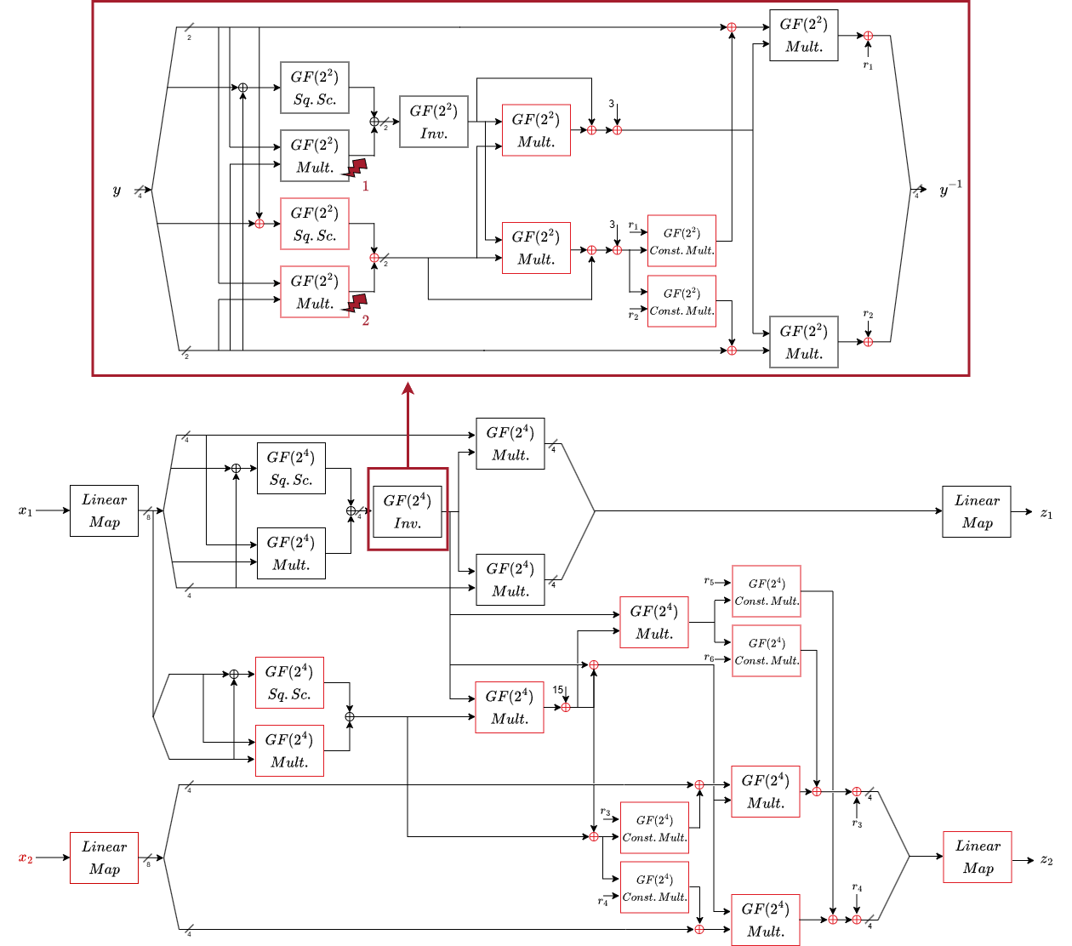
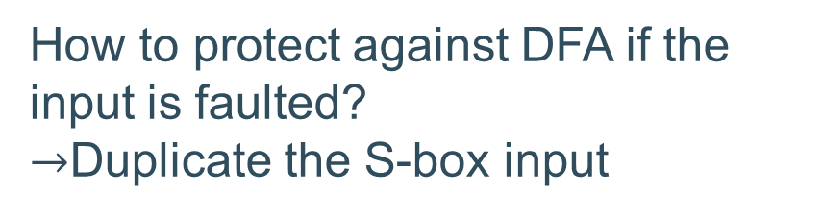
Hardware Implementation
How to protect against DFA if the input is faulted?
$→$Duplicate the S-box input

Slide 18
Hardware Implementation
Over three shares, based on Consolidating Masking Schemes⁶
Second-order SCA, first-order fault protection
  TVLA evaluation
  Fault evaluation
    Provable methods are not applicable/feasible
    Assessed the detection rate across all inputs for faulting each component in the S-box
    Assessed the distribution of output differences across all inputs and fault values
6- O. Reparaz, B. Bilgin, S. Nikova, B. Gierlichs, I. Verbauwhede: Consolidating Masking Schemes
Notes:
CMS is not secure for 3rd order

Slide 19

Conclusion
Several vulnerabilities in RS-Mask
  Insufficient evaluation
We need more comprehensive fault evaluations
An AES-specific countermeasure with a uniform mapping
Thank you!

Slide 20
References
1- K. Ramezanpour, P. Ampadu, W. Diehl: RS-Mask: Random Space Masking as an Integrated Countermeasure against Power and Fault Analysis
2- O. Reparaz, L. De Meyer, B. Bilgin, V. Arribas, S. Nikova, V. Nikov, N. P. Smart: CAPA: The Spirit of Beaver Against Physical Attacks
3- J. Feldtkeller, J. Richter-Brockmann, P. Sasdrich, T. Guneysu: CINI MINIS: Domain Isolation for Fault and Combined Security
4- S. Faust, V. Grosso, S. M. D. Pozo, C. Paglialonga, F. Standaert: Composable Masking Schemes in the Presence of Physical Defaults & the Robust Probing Model
5- S. Dhooghe, A. Ovchinnikov, D. Toprakhisar: StaTI: Protecting against Fault Attacks Using Stable Threshold Implementations
6- O. Reparaz, B. Bilgin, S. Nikova, B. Gierlichs, I. Verbauwhede: Consolidating Masking Schemes

Slide 21
An AES-specific Countermeasure
  $$\left(y+yy^{−1}+1\right)\left(y^{−1}+yy^{−1}+1\right)=1$$
  $$x_{0}\left(yy^{−1}+1\right)=0$$
  $$x_{1}\left(yy^{−1}+1\right)=0$$
$$z_{1}^{′}=z_{1}+r_{1}=$$
$$z_{0}^{′}=z_{0}+r_{0}=$$
$$x_{0}y^{−1}$$
$$x_{1}y^{−1}$$
$$+\left(y+yy^{−1}+1\right)\left(y^{−1}+yy^{−1}+1\right)r_{1}$$
$$+\left(y+yy^{−1}+1\right)\left(y^{−1}+yy^{−1}+1\right)r_{2}$$
$$=(x_{0}+\left(y+yy^{−1}+1\right)r_{1})(y^{−1}+yy^{−1}+1)$$
$$=(x_{1}+\left(y+yy^{−1}+1\right)r_{0})(y^{−1}+yy^{−1}+1)$$
In order to hide output differential:
  Additional term: $\left(yy^{−1 }+1\right)r^{′}y^{−1}$ which evaluates to zero if there is no fault
What about protecting the $GF(2^{4})$ inversion?

Slide 22

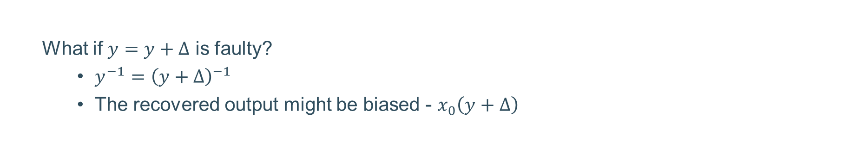
Derivation of RS Mapping For AES S-box Inversion $z^{′}=x^{−1}+r$
$$x≠0$$
$$y≠0, y^{−1}≠0, yy^{−1}=1$$
$$x=0$$
$$y=0, y^{−1}=0$$
  $$=\left[x_{0}+\left(yr_{1}\right)\right]y^{−1}$$
  $$=\left[x_{1}+\left(yr_{0}\right)\right]y^{−1}$$
  $$z_{1}^{′}=z_{1}+r_{1}$$
  $$z_{0}^{′}=z_{0}+r_{0}$$
  $$yy^{−1}r_{1}$$
  $$yy^{−1}r_{0}$$
  $${=x}_{0}y^{−1}+$$
  $${=x}_{1}y^{−1}+$$
  $$=\left[x_{0}+\left(yr_{1}\right)\right]y^{−1}$$
  $$=\left[x_{1}+\left(yr_{0}\right)\right]y^{−1}$$
    $$yy^{−1}r≠r$$
  What if $y=y+Δ$ is faulty?
    $y^{−1}={\left(y+Δ\right)}^{−1}$
    The recovered output might be biased - $x_{0}\left(y+Δ\right)$
  $$z_{1}^{′}=z_{1}+r_{1}$$
  $$z_{0}^{′}=z_{0}+r_{0}$$
    Use a separate datapath to compute $y$ from the input $x$
  $$z^{′}=0+r$$
  $$z^{′}={\left(r^{−1}\right)}^{−1}$$
Notes:
Canright construction breaks the inversion into smaller subfield operations

Slide 23
Physical Attacks
2- Active Attacks
Fault Attacks (FA)
  Intentional disturbance of computations
    e.g., Clock/voltage glitches
  Countermeasures
    Redundancy + masking
    Error correction
    Error check all the critical values
    Ensure fault propagation
    Random space masking (RS-Mask¹)
1- K. Ramezanpour, P. Ampadu, W. Diehl: RS-Mask: Random Space Masking as an Integrated Countermeasure against Power and Fault Analysis

Slide 24
Physical Attacks
2- Active Attacks
Fault Attacks (FA)
  Countermeasures
    Redundancy + masking
    Error correction
    Error check all the critical values
    Ensure fault propagation
    Random space masking (RS-Mask)

Slide 25

















Physical Attacks
2- Active Attacks
Fault Attacks (FA)
  Exploitation techniques
    Wrong ciphertexts
    Correct ciphertexts
    Data-dependent fault propagation
Bit flip
$$x$$
$$0$$
$$0$$
$$1$$
$$1$$
$$y$$
$$0$$
$$1$$
$$0$$
$$1$$
$$y′$$
$$1$$
$$0$$
$$1$$
$$0$$
$$xy$$
$$0$$
$$0$$
$$0$$
$$1$$
$$xy′$$
$$x$$
$$0$$
$$0$$
$$1$$
$$1$$
$$xy$$
$$0$$
$$0$$
$$0$$
$$1$$
$$x$$
$$0$$
$$0$$
$$1$$
$$1$$
$$y$$
$$0$$
$$1$$
$$0$$
$$1$$
$$y$$
$$0$$
$$1$$
$$0$$
$$1$$
$$y′$$
$$x$$
$$0$$
$$0$$
$$1$$
$$1$$
$$y$$
$$0$$
$$1$$
$$0$$
$$1$$
$$y′$$
$$1$$
$$0$$
$$1$$
$$0$$
$$xy$$
$$0$$
$$0$$
$$0$$
$$1$$
$$xy$$
$$0$$
$$0$$
$$0$$
$$1$$
$$xy′$$
$$0$$
$$0$$
$$1$$
$$0$$
ineffective fault

Slide 26





RS-Mask
Goal: Maintain uniformity under fault injection
Core idea:
  Map variables to a random space
  Perform operations in that space
  Transform the result back to the original space
Protected AES
  First-order SCA
  First-order fault security
$$x$$
$$ℰ_{1}$$
$$g(⋅)$$
$$ℰ_{2}$$
$$z=g(x)$$

Slide 27





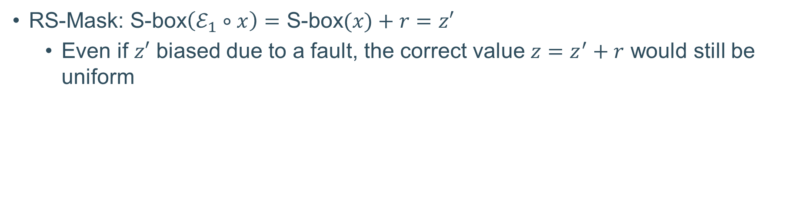
Random Space Mapping
For a non-linear function $g(⋅)$ with a random mapping $ℰ_{1}$ and the dual mapping $ℰ_{2}$:
Correctness
Uniformity
Robustness
$$x$$
$$ℰ_{1}$$
$$g(⋅)$$
$$ℰ_{2}$$
$$z=g(x)$$
RS-Mask: S-box$\left(ℰ_{1}∘x\right)=$ S-box$(x)+r=z′$
  Even if $z′$ biased due to a fault, the correct value $z=z^{′}+r$ would still be uniform
Notes:
Uniformity: $ℰ_{1}$ should be uniform, so it maps the input to any value in the space with the same probability
Robustness: the distribution of values at the output of $ℰ_{2}$ must be uniform under fault injection without masking

Slide 28
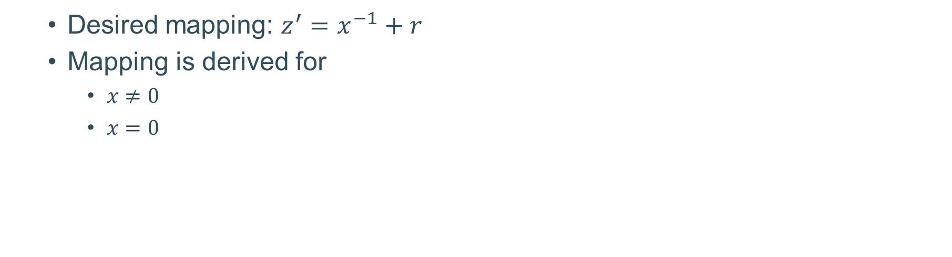
Derivation of RS Mapping For AES S-box Inversion
  Desired mapping: $z^{′}=x^{−1}+r$
  Mapping is derived for
    $x≠0$
    $x=0$

Slide 29




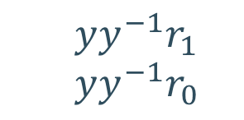

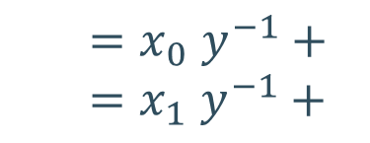

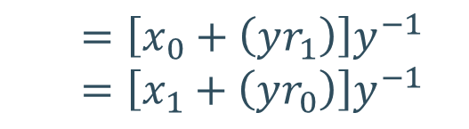
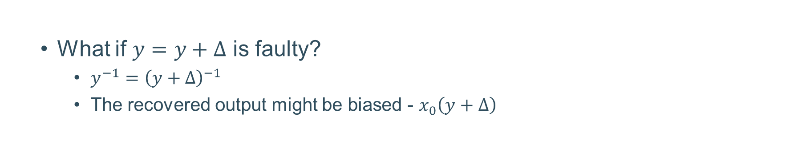

Derivation of RS Mapping for $x≠0$
$$≠0$$
$$≠0$$
$$yy^{−1}=1$$
$$≠0$$
  $$z_{1}^{′}=z_{1}+r_{1}$$
  $$z_{0}^{′}=z_{0}+r_{0}$$
  $${=x}_{0}y^{−1}+$$
  $${=x}_{1}y^{−1}+$$
  $$yy^{−1}r_{1}$$
  $$yy^{−1}r_{0}$$
  $$=\left[x_{0}+\left(yr_{1}\right)\right]y^{−1}$$
  $$=\left[x_{1}+\left(yr_{0}\right)\right]y^{−1}$$
  What if $y=y+Δ$ is faulty?
    $y^{−1}={\left(y+Δ\right)}^{−1}$
    The recovered output might be biased - $x_{0}\left(y+Δ\right)$
    Use a separate datapath to compute $y$ from the input $x$

Slide 30



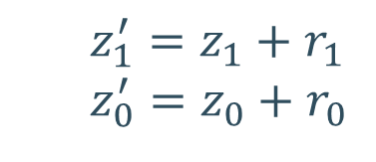
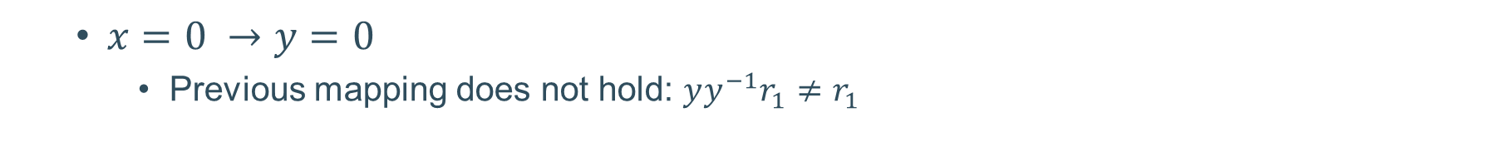
Derivation of RS Mapping for$x=0$
  $x=0 →y=0$
    Previous mapping does not hold: $yy^{−1}r_{1}≠r_{1}$
  $$z_{1}^{′}=z_{1}+r_{1}$$
  $$z_{0}^{′}=z_{0}+r_{0}$$
  $$z^{′}=0+r$$
  $$z^{′}={\left(r^{−1}\right)}^{−1}$$

Slide 31
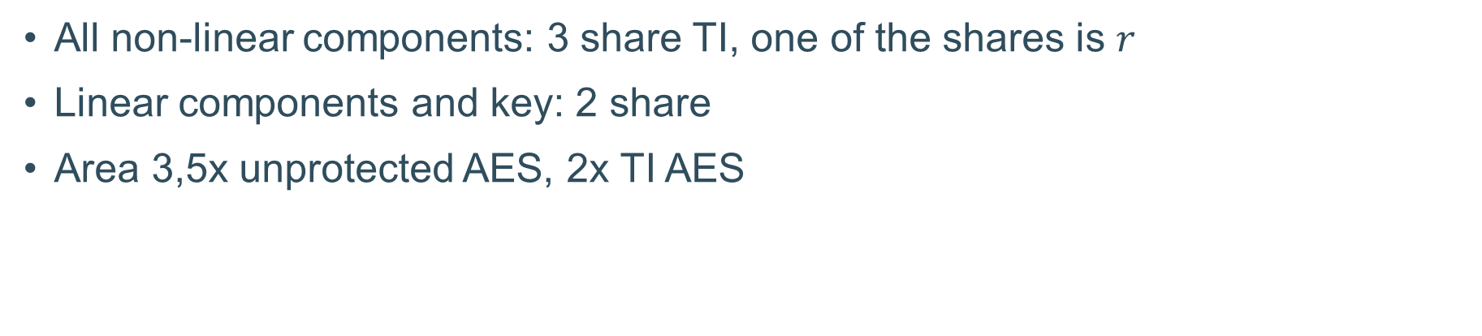
Hardware Implementation of RS-Mask on AES
All non-linear components: 3 share TI, one of the shares is $r$
Linear components and key: 2 share
Area 3,5x unprotected AES, 2x TI AES

Slide 32
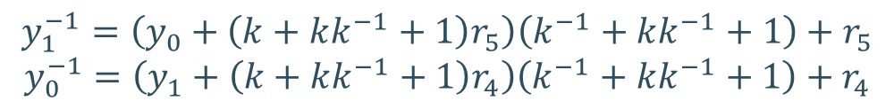
An AES-specific Countermeasure
What about the inner $GF(2^{2})$ inversion?
$$y_{1}^{−1}=\left(y_{0}+\left(k+kk^{−1}+1\right)r_{5}\right)\left(k^{−1}+kk^{−1}+1\right)+r_{5}$$
$$y_{0}^{−1}=\left(y_{1}+\left(k+kk^{−1}+1\right)r_{4}\right)\left(k^{−1}+kk^{−1}+1\right)+r_{4}$$

Slide 33
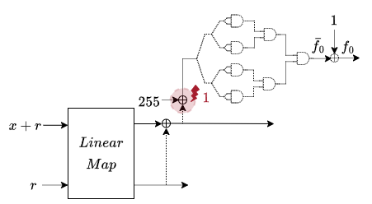
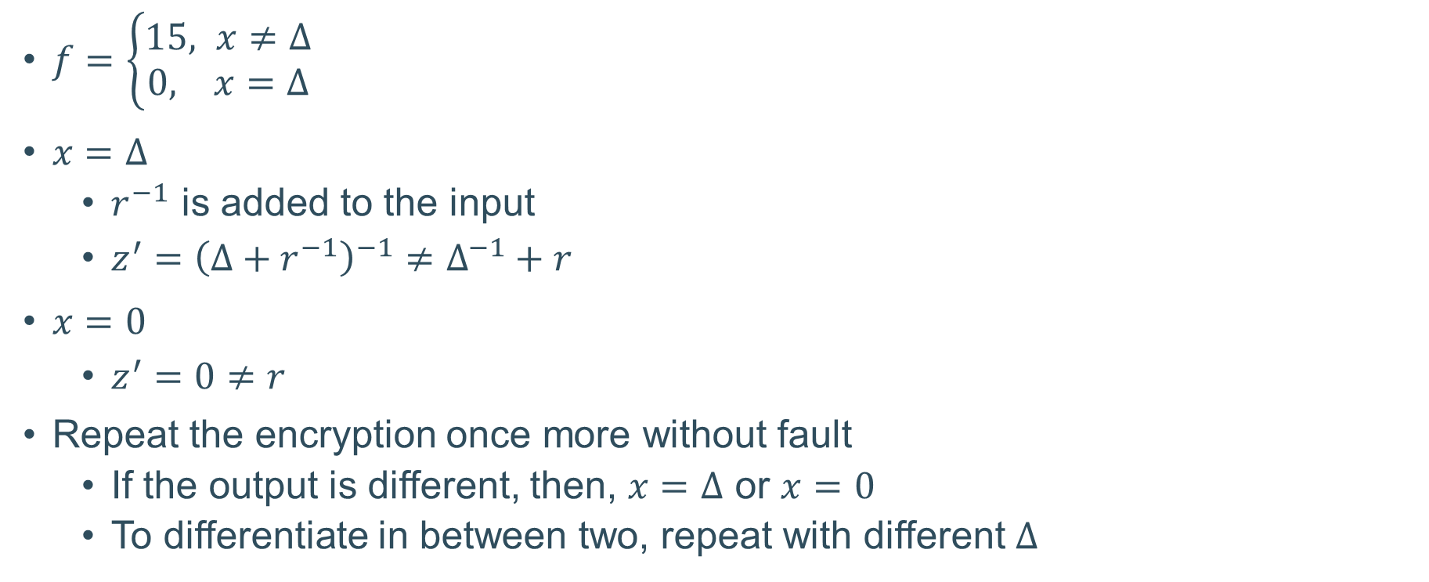

Fault Location 1 - Kronecker Delta Function
$$x+255+Δ$$
$f=\left\{\begin{aligned}15, x≠Δ \\ &0, x=Δ\end{aligned}\right.$
$x=Δ$
  $r^{−1}$ is added to the input
  $z^{′}={\left(Δ+r^{−1}\right)}^{−1}≠Δ^{−1}+r$
$x=0$
  $z^{′}=0≠r$
Repeat the encryption once more without fault
  If the output is different, then, $x=Δ$ or $x=0$
  To differentiate in between two, repeat with different $Δ$

Slide 34
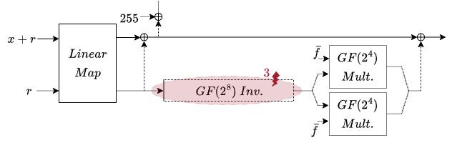

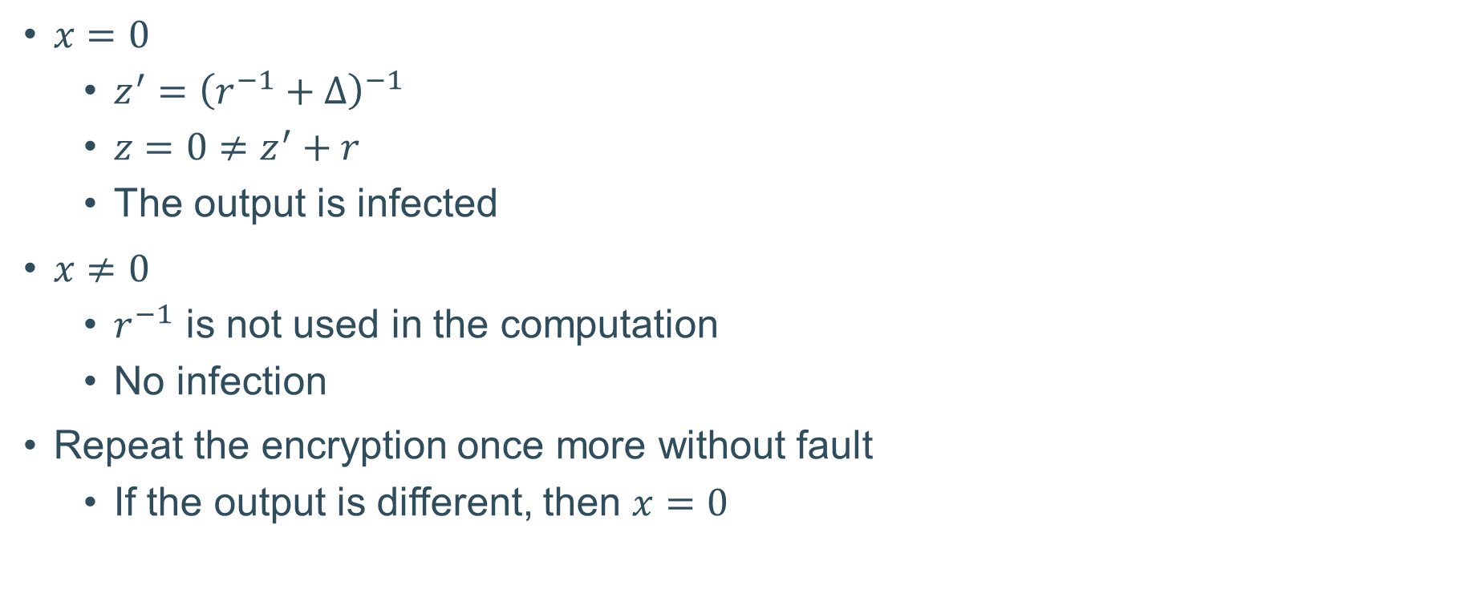

Fault Location 3 – Inversion of $r$
$x=0$
  $z^{′}={\left(r^{−1}+Δ\right)}^{−1}$
  $z=0≠z^{′}+r$
  The output is infected
$x≠0$
  $r^{−1}$ is not used in the computation
  No infection
Repeat the encryption once more without fault
  If the output is different, then $x=0$
$$r^{−1}=r^{−1}+Δ$$

Slide 35

Hardware Implementation

